Slide 1

E-COMMERCE DASHBOARD
Project Report
Puneet Singh

Slide 2
Objective
To design a dashboard for an E-Commerce company which can help understand the trends of sales and profits.
To add a User Control Combo Box for the product category.

Slide 3
Benefits
The dashboard will help company
Understand the trends of Monthly Sales and Profits.
Which region generates the maximum and minimum sales.
Which regions and product categories need to be focussed in order to boost the sales.
Distribution of orders in different age-groups.

Slide 4
Problem Statement
An online e-commerce company's analytics team wants to create a sales dashboard to evaluate sales based on different product categories. The business aims to provide people more choice over product categories so they may choose one and can observe the trend month- and product-wise as appropriate.

Slide 5
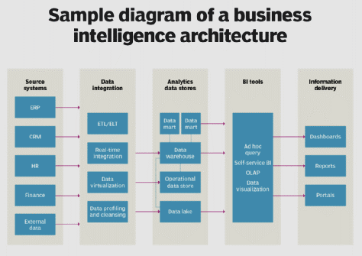
Architecture
Source: https://www.techtarget.com/searchbusinessanalytics/definition/business-intelligence-architecture

Slide 6
Dataset
The dataset of the e-commerce company is provided in the form of Excel workbook.
The dataset contains the following columns:
Order ID, Order Date, Ship Date, Aging, Ship Mode, Product Category, Product, Sales, Quantity, Discount, Profit, Shipping Cost, Order Priority, Customer ID, Customer Name, Segment, City, State, Country, Region, Months

Slide 7
Data Transformation
The dataset doesn’t have any null values and is clean. It is then used for analysis.
SUMIFS function is used to calculate the sales, profit and quantity metrics.

Slide 8

Tool Used
Microsoft Excel is used to design the dashboard to gain insights about the sales and profits trends of the company.
Source: https://commons.wikimedia.org/wiki/File:Microsoft_Office_Excel_%282019%E2%80%93present%29.svg

Slide 9
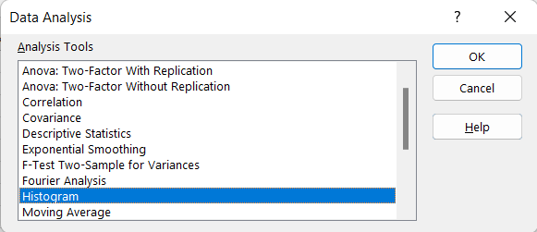
Steps to create Dashboard - 1
Step1: Create Histogram for Shipping Days(Aging)
To create histogram, click the Data Tab, Under Analysis Group (Right Corner), Click Data
Analysis.
Now, select Histogram and click OK. A histogram dialog box will appear. Add the required range.

Slide 10
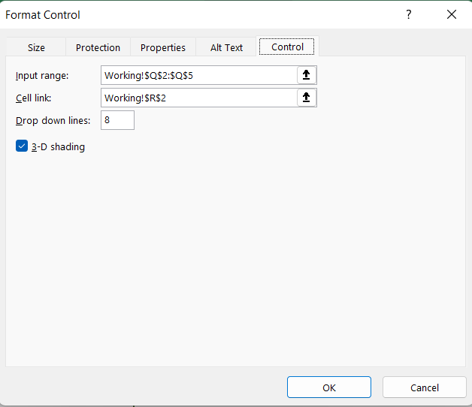
Steps to create Dashboard - 2
Step 2: Create Combo Box:
Insert Combo box for product category list in the Dashboard Sheet.
Click Developer Tab > Under Controls Panel > Click Combo box and Draw.

Slide 11
Steps to create Dashboard - 3
Step 3: SUMIFS formula to calculate Total Sales, Quantity, and Profit
Now, write SUMIFSs formula to calculate Sales, Quantity, and Profit in the Dashboard sheet.

Slide 12
Steps to create Dashboard - 4
Step 4: SUMIFS formula to calculate Sales and Profit month wise
Now write the SUMIFS formula to calculate the Sales and Profit month-wise and sales region-wise.

Slide 13
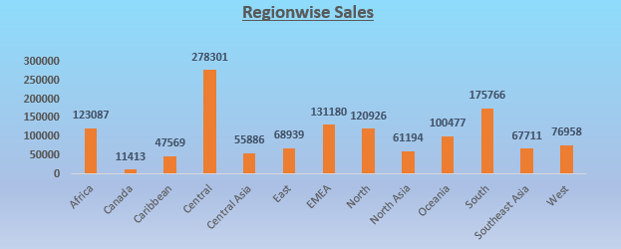
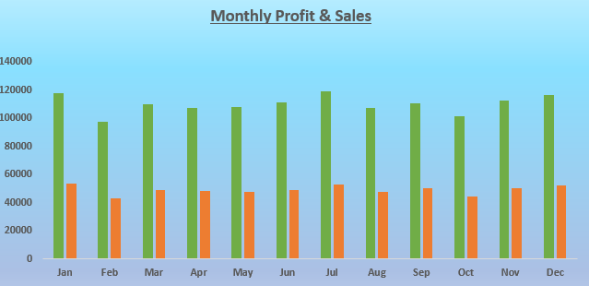
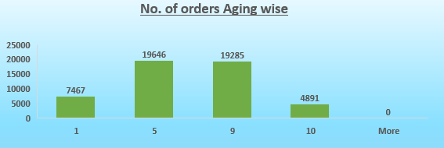
Steps to create Dashboard - 5
Step 5: Create Column Charts
Now, create the column charts for different tables created before.

Slide 14
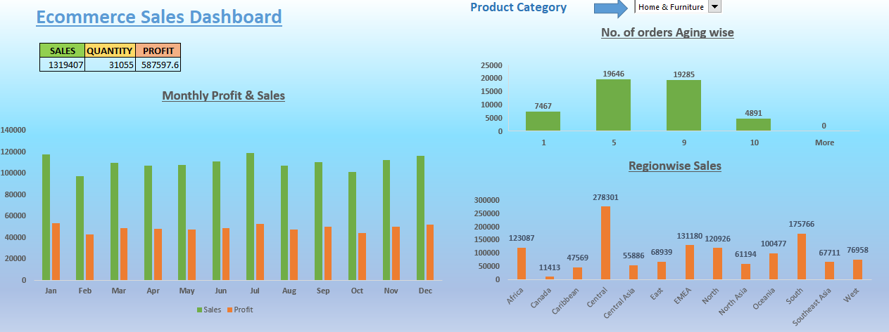
Dashboard

Slide 15
Insights
Electronics is the least-selling category and is preferred by age group 0-1 only.
The Central region generates the maximum sales for the company.
In categories other than the Electronics, the distribution of orders is almost similar for all the age groups.
The sales and profit trends for each category keeps on changing monthly.

